Slide 1
Covid 19 Detection in X-Ray Images
Kellie Halladay, Jake Prichard, and Ruiying Liu

Slide 2
Executive Summary
We created a Support Vector Machine model that predicts the presence of covid-19 pneumonia in chest x-rays. Our model is able to distinguish between covid-19 pneumonia and other types of pneumonia quite well. However, it struggles to distinguish between covid-19 x-rays and normal x-rays. Our results varied depending on the test set that was used.
Set | Accuracy | Precision | Recall | F1
Small Test Set | 95.58% | 97.44% | 90.48% | 93.83%
Large Test Set | 72.09% | 62.93% | 93.11% | 75.10%
Both | 74.79% | 65.10% | 92.85% | 76.54%

Slide 3
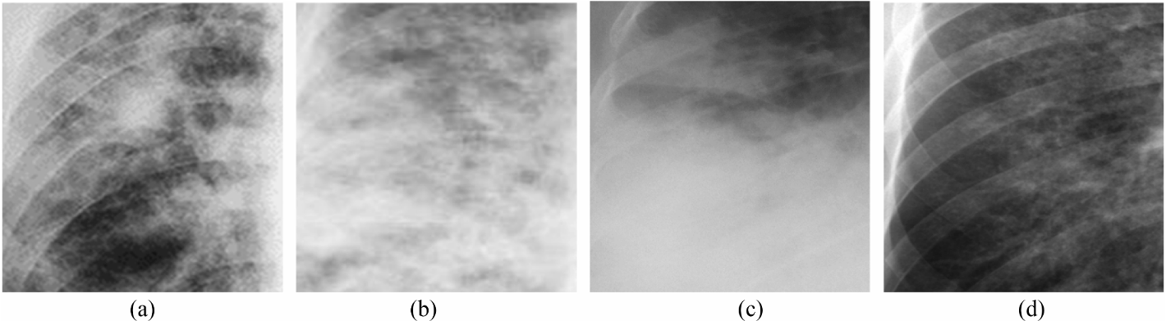
Introduction
COVID- 19 is an extremely contagious disease and caused world wide pandemic in 2020
Chest X-ray imaging is effective way for lung disease detection
The symptom of COVID-19 is similar to normal virus induced Pneumonia and other kinds of Pneumonia based on Chest X-ray imaging
Biological methods like Reverse transcription polymerase chain reaction(RT-PCR) and ELISA antibody kits were widely used during pandemic, but it costly and time-consuming
COVID-19 infected Chest X-ray images showing:
(a) patchy Ground-glass opacities, (b) Reticular opacities,
(c) Pulmonary consolidation, (d) Mild opacities.
Chandra et al. 2021

Slide 4
The Data
Source: ‘COVID-19 Detection in Chest X-Ray Images’ from class midterm repository
Original Source: https://data.mendeley.com/datasets/fvk7h5dg2p/1
603 chest x ray images taken during 2019-2020
Class breakdown
-Normal: 234 (39%)
-Pneumonia: 148 (36%)
-Covid-19 Pneumonia: 220 (25%)

Slide 5
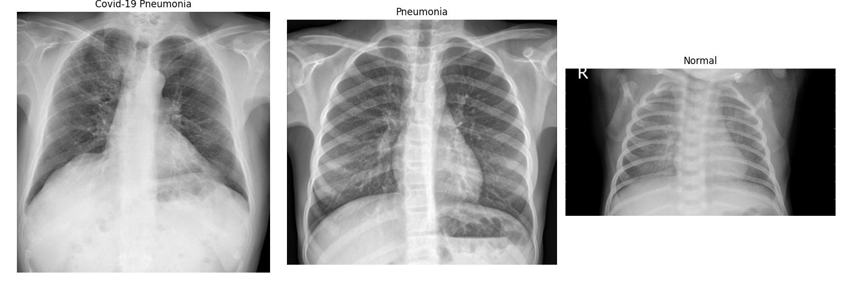
The Task
Build a machine learning model that can distinguish between covid-19 pneumonia and other types of pneumonia and can also distinguish between covid-19 pneumonia and healthy lungs
Causes White opacities in the chest
Causes White opacities in the chest

Slide 6
The Task
Binary Classification:
Positive Class: All covid-19 X-rays
Negative Class: All other X-rays (normal and other pneumonias)

Slide 7
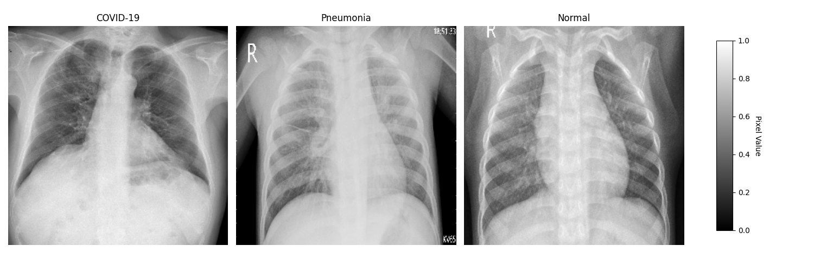
Image Preprocessing
The images need to be of consistent resolution. We started by resizing all images to be 224 X 224 pixels.

Slide 8
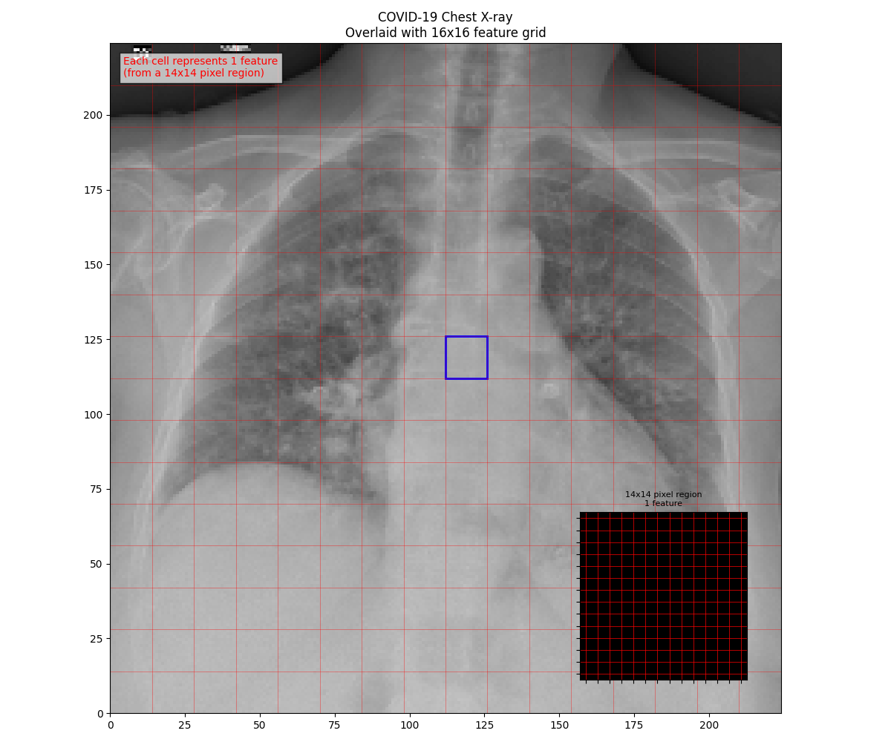
Extracting features for our models
Our features would be the grayscale intensity values from each pixel associated with an (n x n) grid. The image at left shows a grid. Within each grid cell there are 196 features (14 x 14). We originally processed the images to be 224 x 224, giving us a total of 50176 gray scale values to serve as features for our model.

Slide 9
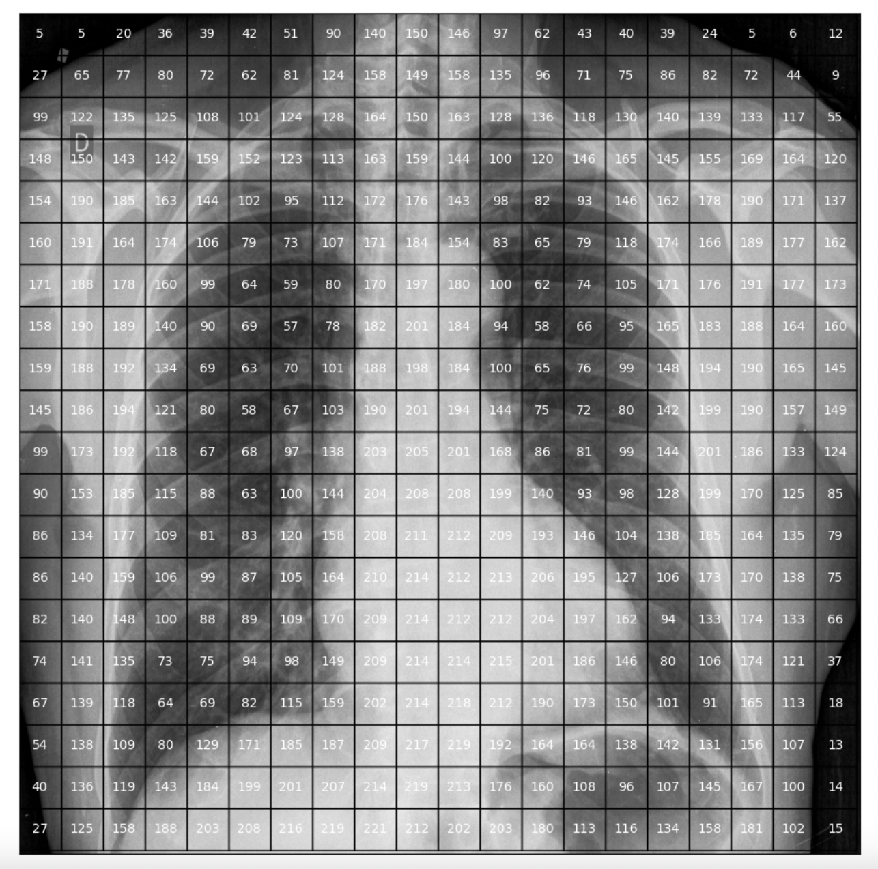
Features
The grayscale values for each pixel are on the scale 0 to 255. 0 is completely black and 255 is completely white. We normalized them to be on the scale 0 to 1.

Slide 10
Training and Testing Sets
Split: 80%, 20%
Stratify: Binary Label
We set aside 20% of our data for testing and kept 80% for training our models. We stratified the data so that both the training and test sets would contain the same class distribution.
Tota data points: 603
Training set: 482 Testing Set: 121
With covid: 177 (37%) With covid: 44 (37%)
Normal: 305 (63%) Normal: 77 (63%)

Slide 11
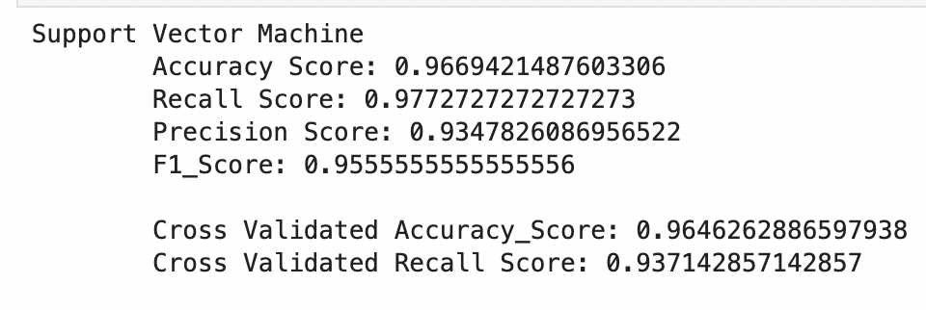
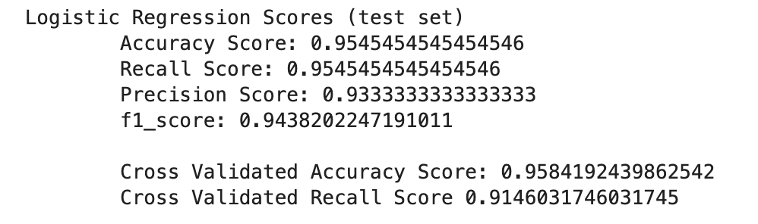
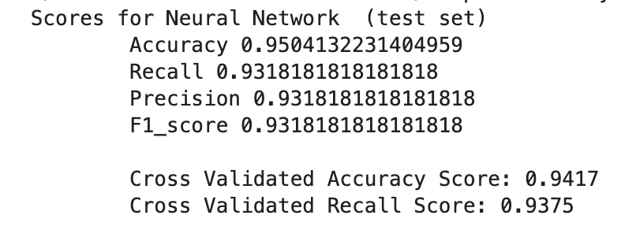
Three Initial Models were fit to see how models would perform without processing and model tuning.

Slide 12
Outlier Detection and Possible Hidden Labels
-A isolation forest reveals that there are a number of outliers in our data set. Taking a closer look at the images, suggests that there may be some patterns in the images that the models could be picking up on that are not medically relevant.
3 main types of outliers identified:
-Images taken from a side angle
-Images that are annotated by radiologists
-CT scan images

Slide 13
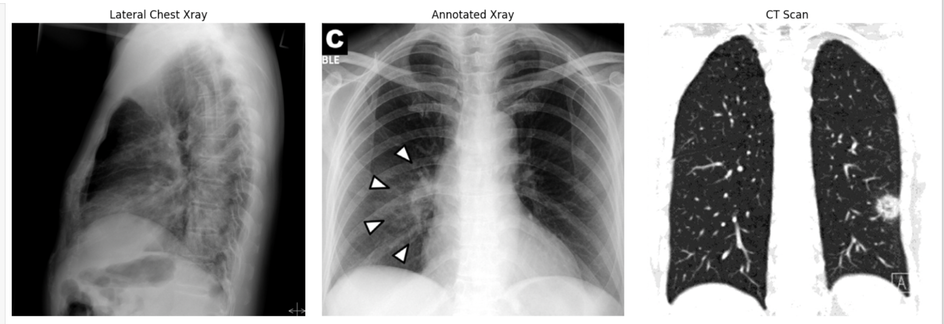
Anomalies In The Data Set
We found 41 total images of these three types of outliers. All of these 41 data points belong to the positive class. These points could potentially cause our models to learn to associate these attributes with positive labels instead of learning the attributes and patterns that are actually associated with covid-19 pneumonia. We thus decided to remove all instances of these types of images.

Slide 14
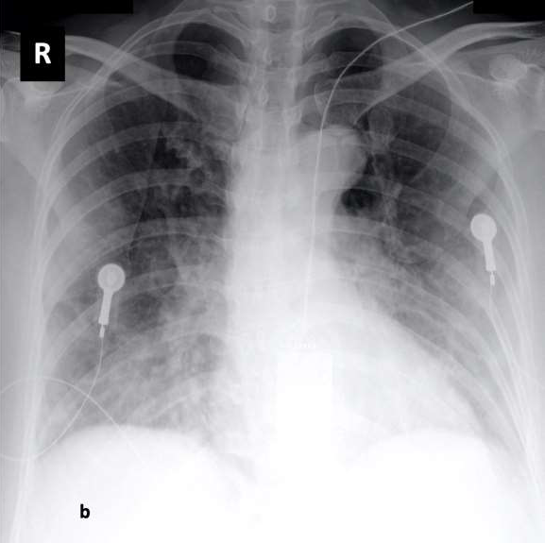
Other Data Set Characteristics That Are Unbalanced
Gender imbalance-Very little of the normal/pneumonia X-rays appear to be of female patients. In other words, we have another occurrence of an attribute that is only present in the positive class.
Medical Equipment-Many of the images have medical equipment in the area of interest (the chest). These are again inconsistently distributed among the three classes. None of the X-rays labeled as Normal have medical equipment. There are some images with medical equipment in the pneumonia images, but images with equipment are primarily of the covid class.

Slide 15
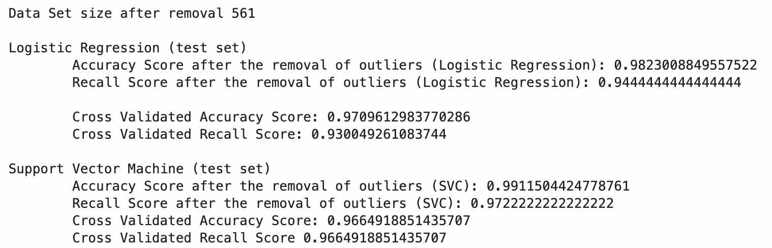
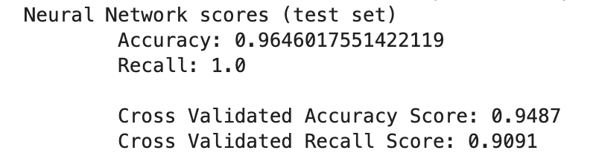
How Did removing the outliers affect model performance
After removing the outliers we were left with a data set containing 561 points.

Slide 16
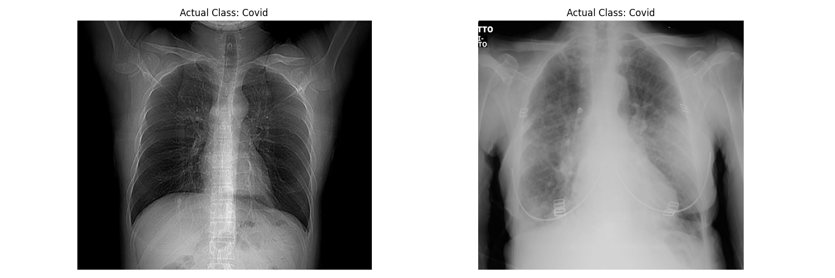
What did the Models Miss?
The logistic regression misclassified only two images. Both were false negatives.
False Negative
False Negative

Slide 17
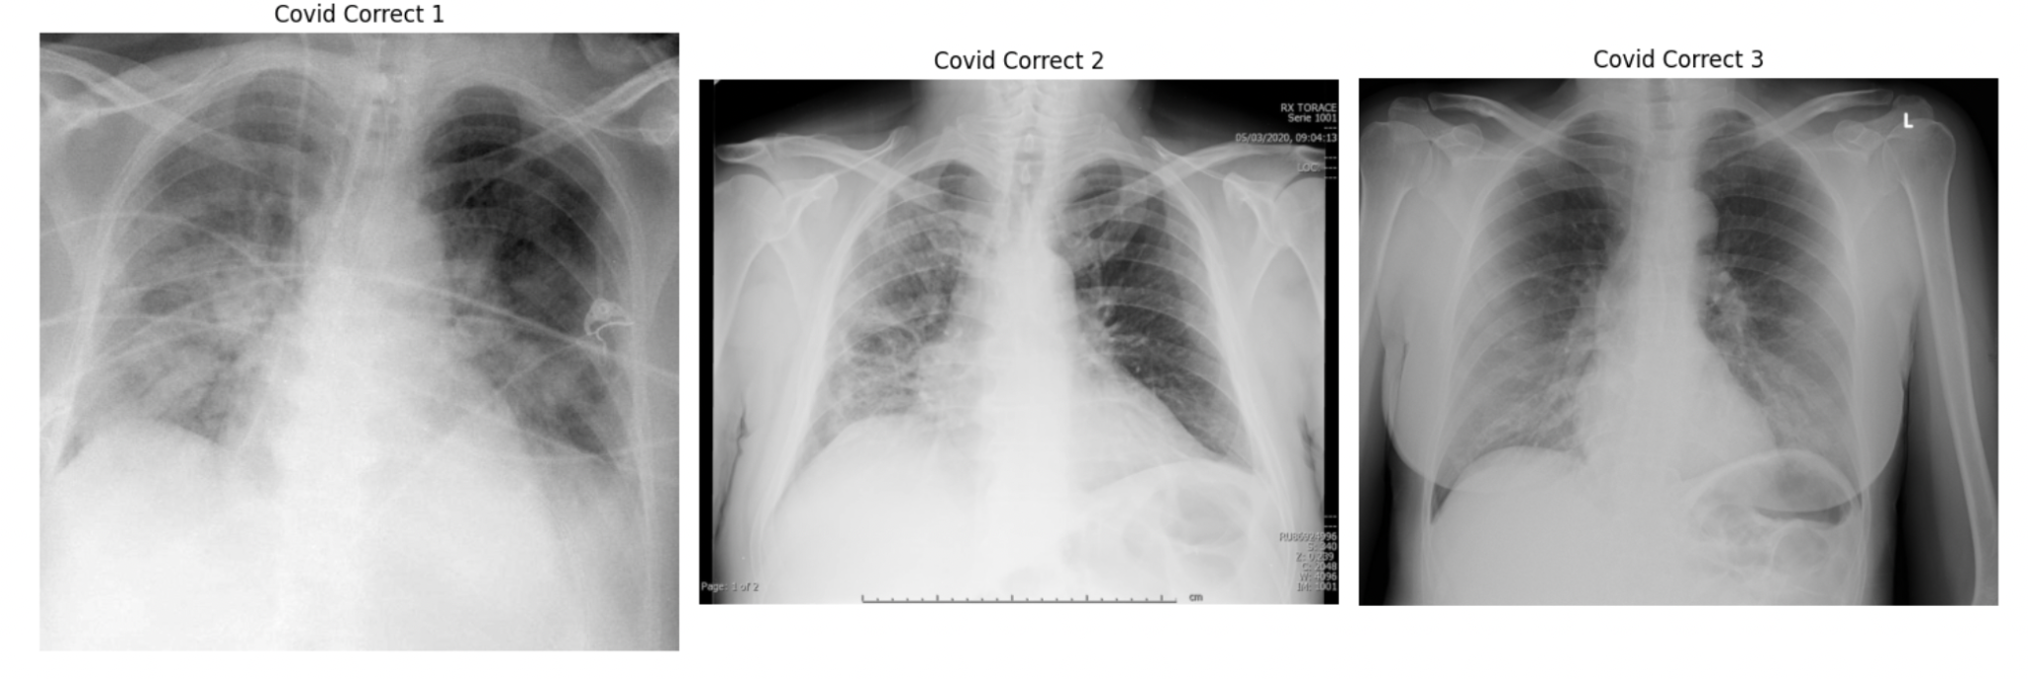
A look at correctly classified positive cases

Slide 18
Monitoring Performance on Outside Dataset
Because of the potential for hidden labels that may be consistent across our training and testing sets, we decided to monitor our models’ performance on data gathered from another source.
Data set used for Testing: COVID-19 Radiography Database
kaggle link: https://www.kaggle.com/datasets/tawsifurrahman/covid19-radiography-database
We took a samples of 867 images from the Covid-19 Radiography Database. The distribution of the labels is 392 covid-19 pneumonia, 229 pneumonia and 226 normal chest xrays.
To ensure that our models are able to generalize well to outside data, we will monitor the performance of both our existing test set as well as this data set.

Slide 19
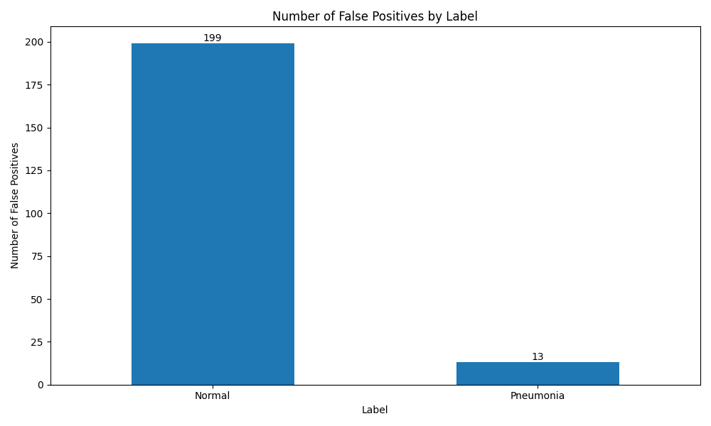
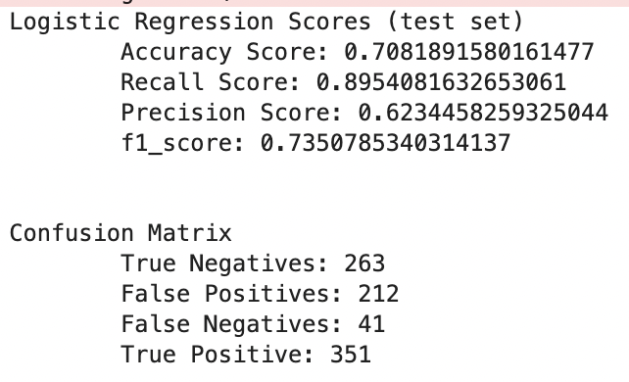
Model Performance on Outside Testing Set.
-We tested our logistic regression model on the newly obtained images. The first thing we notice was that the overall performance was not nearly as good. We see that the the logistic regression model was able to classify the positive class quite accurately, missing only about 10% of the covid cases. However, we also see that the model generated many false positives.

Slide 20
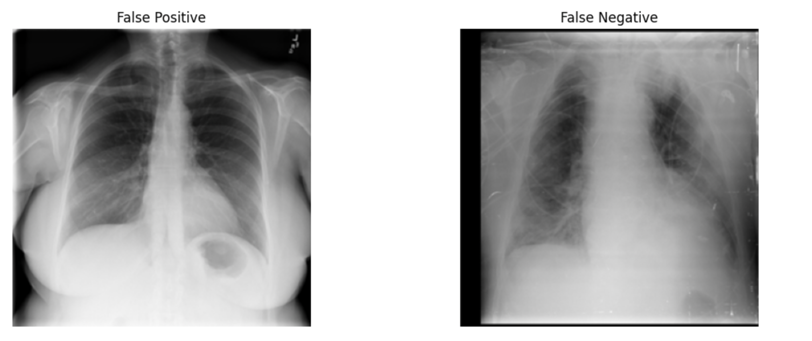
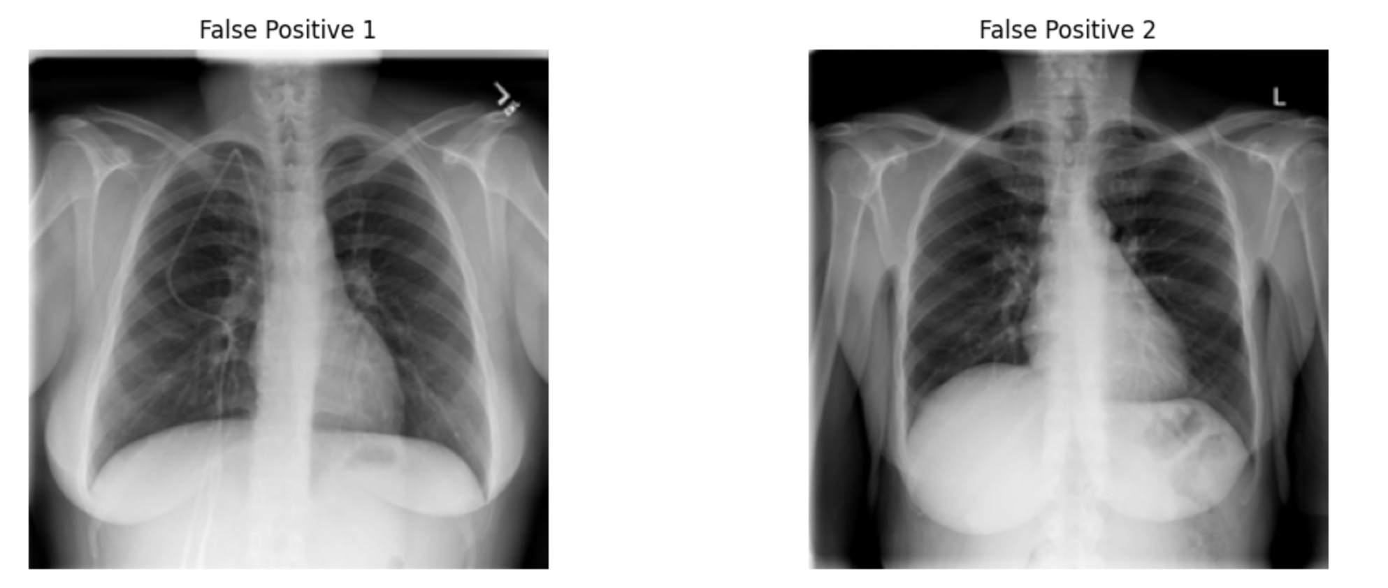
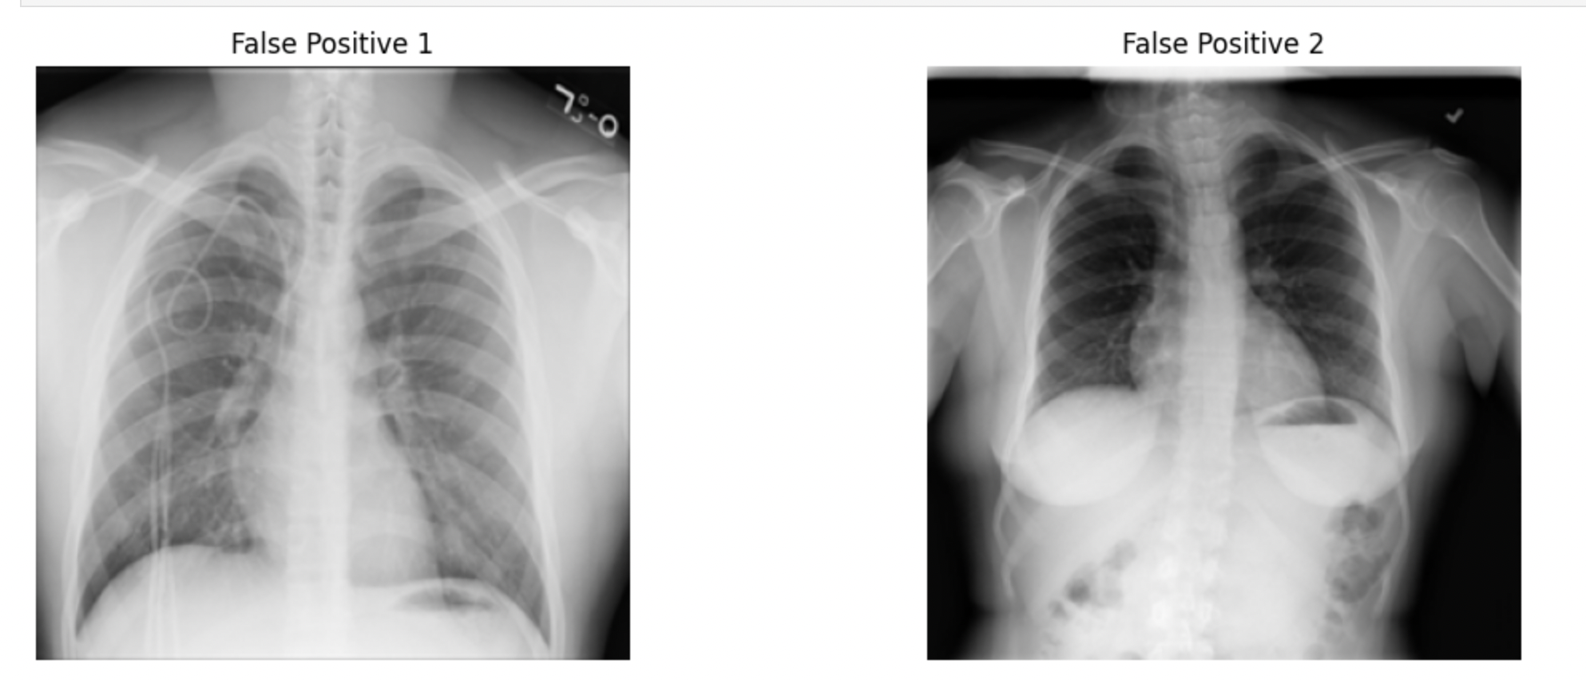
Misclassifications on Outside Data
We see a pattern; there seem to be a lot of false positives that are female.
A Look At False Positives

Slide 21
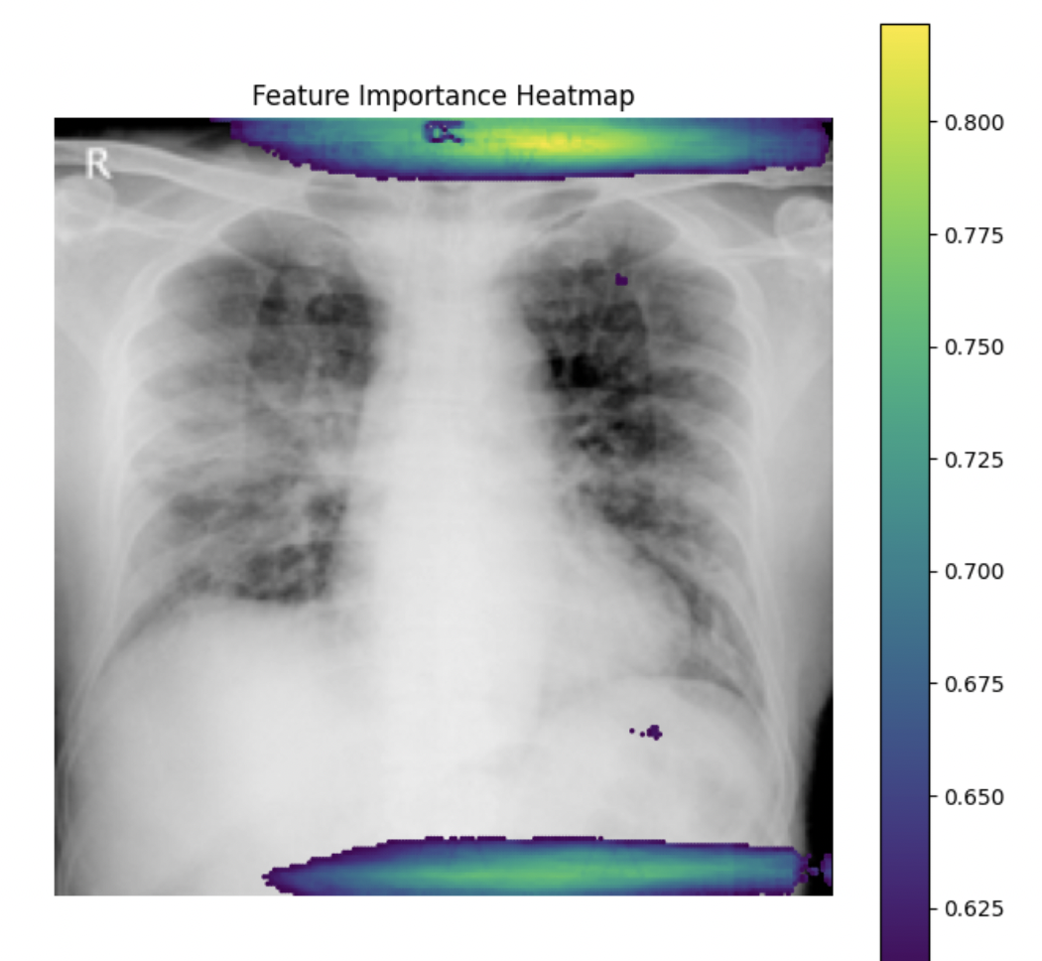
What exactly are models picking up on?
-Correlation analysis: We took each of the 50,176 features and performed correlation analysis between each feature and the target variable. Features with the top 7000 correlation coefficients (absolute value) were plotted, overlaying one of the xrays.
-Notice that some of the highly correlated features are actually connected to areas that are in the lungs.
-However, it seems problematic that the most correlated features seem to be in areas that have nothing to do with pneumonia and covid-19.

Slide 22
Deciding to Crop the images
-Most of the correlated features seem to be in areas that should not be medically correlated with having covid-19. The models could be picking up on irrelevant aspects of the image and mistaking them as important.
-Cropping the images will allow our models to focus on features that are related to having covid-19.

Slide 23
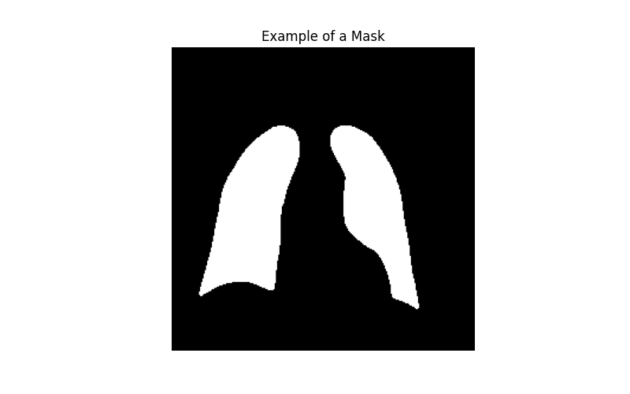
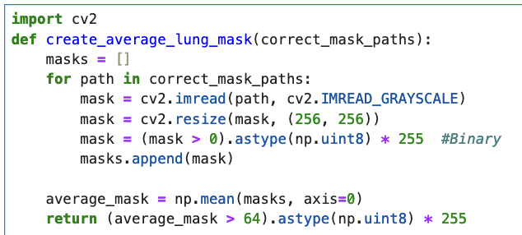
Leveraging Lung Masks to crop images to lungs.
Data Source: COVID-19 Radiography Database
Lung masks were used To find the location of the lungs in our images.
-The Covid-19 Radiography Database includes lung masks for each image. These were used as a guide to find the lungs in our images.
-We took the masks that are in the dataset and averaged all of the pixel
values for each mask. This average mask then served as a guide to find the lungs in our images.

Slide 24
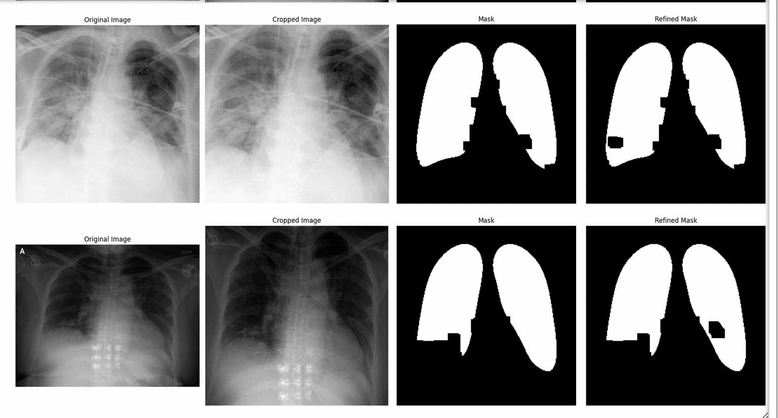
Cropping to the Lungs
The average mask generated from the other data set was then used as a guide to find the lungs in the images in our data set.

Slide 25
Description of the Features after processing
-The images were resized to a resolution of 256X256 after being cropped to the lungs.
-65536 features, 546 rows.

Slide 26
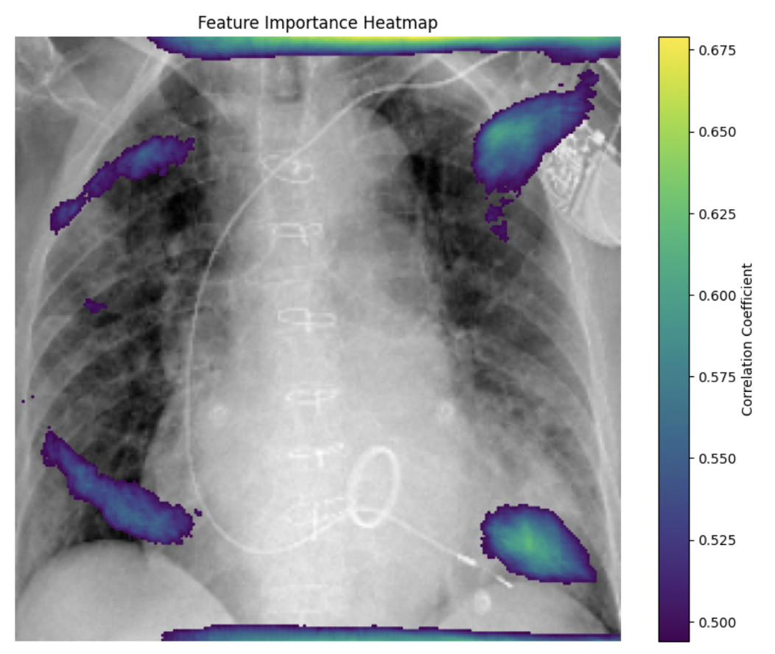
Top 7000 Correlation Coefficient
Correlation Coefficients After Cropping
-The heatmaps suggest that a positive covid-19 label is associated with the intensity values located in the basilar and upper peripheral areas. More specifically the most highly correlated features seem to be in the bottom chest close to the diaphragm.
-Models such as Logistic Regression (which assumes linearity) will likely be weighting these features the highest.

Slide 27
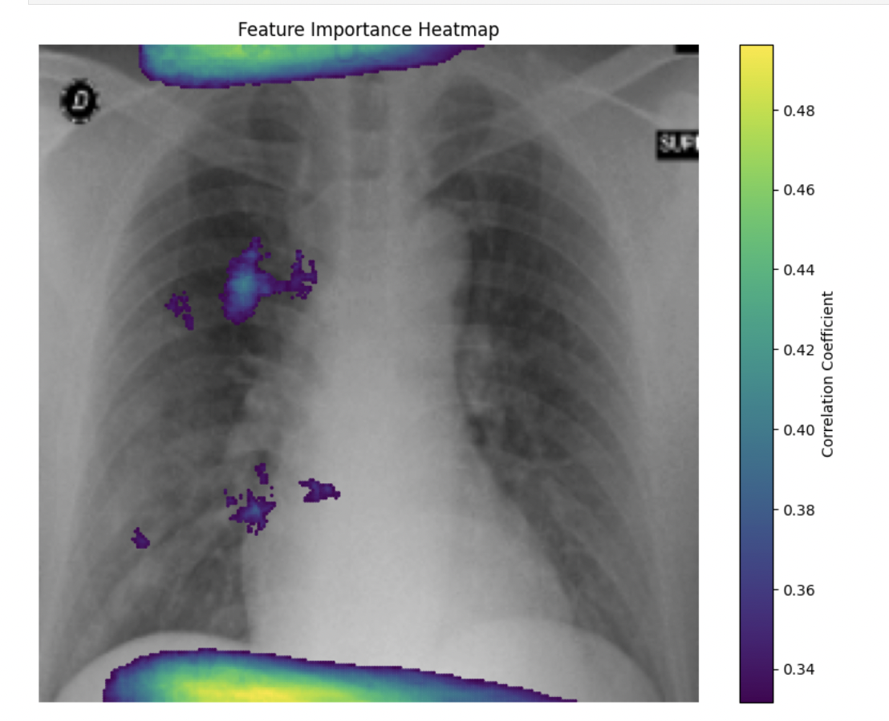
Which Features are Correlated with Pneumonia that is not caused by Covid-19?
-We decided to look at which features are correlated with having viral pneumonia which is not caused by covid-19.
Top 7000 Correlation Coefficients (target non-covid pneumonia)
-The results suggest that non-covid pneumonia is more associated with opacities in the center of the chest. It also suggests that this type of pneumonia is more prominent in the right chest. However, it is still concerning that the highest correlation coefficients lay in areas that are not in the lungs.

Slide 28
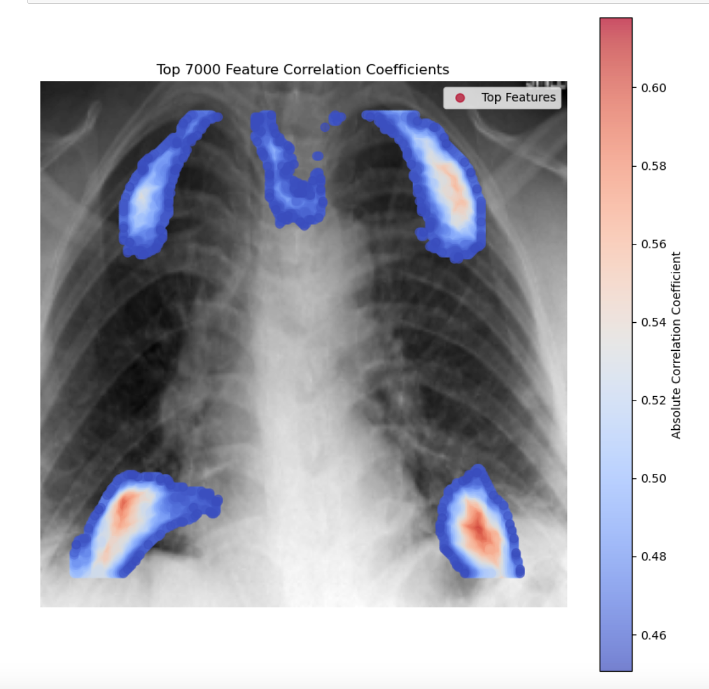
Removing more Noise
To reduce the effect of irrelevant features, we removed roughly 15,000 features from the data.
Correlation coefficients after removing features

Slide 29
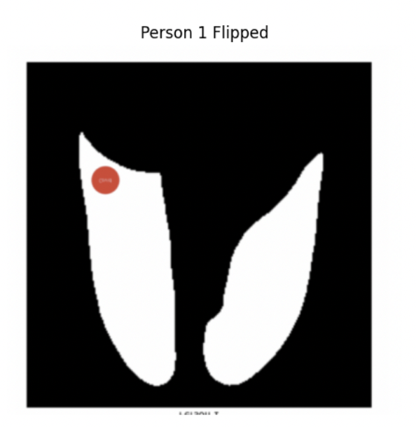
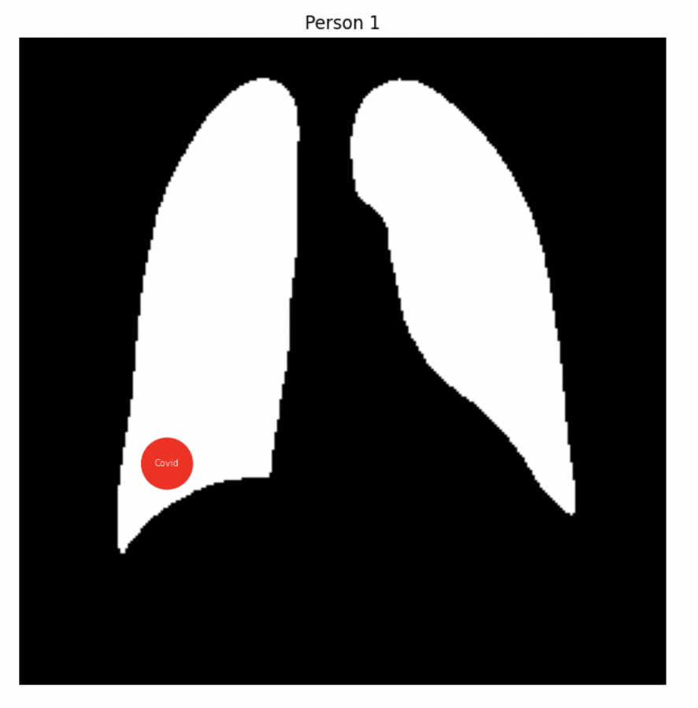
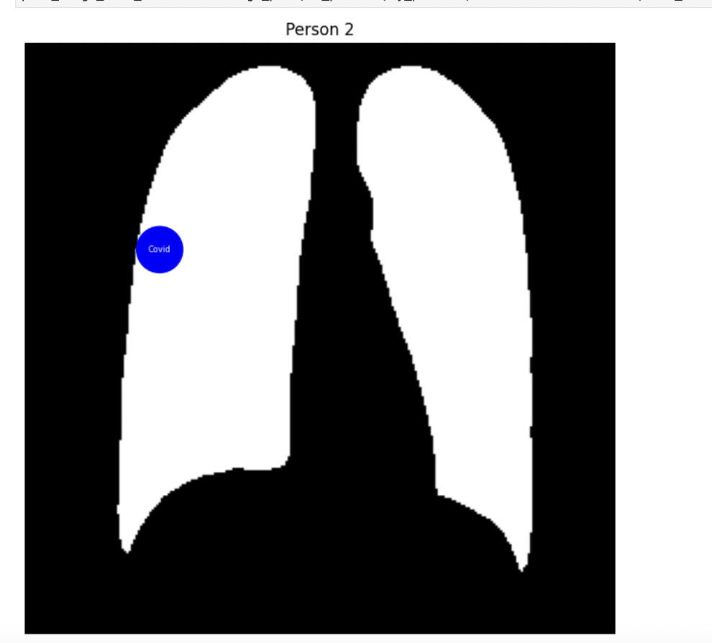
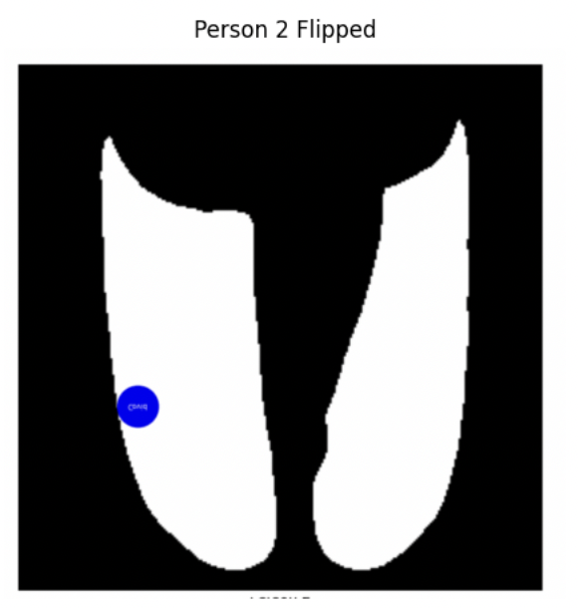
Data Augmentation
Explanation: Since Covid-19 doesn’t discriminate between the top and bottom of the lungs. We can flip each training image to create new training observations. The example below shows two images, one where the covid is at the top of the lungs and the other at the bottom. By flipping the images and adding them to the training set, we create two new training examples for which our algorithm to learn.
Original Samples
Added training data

Slide 30
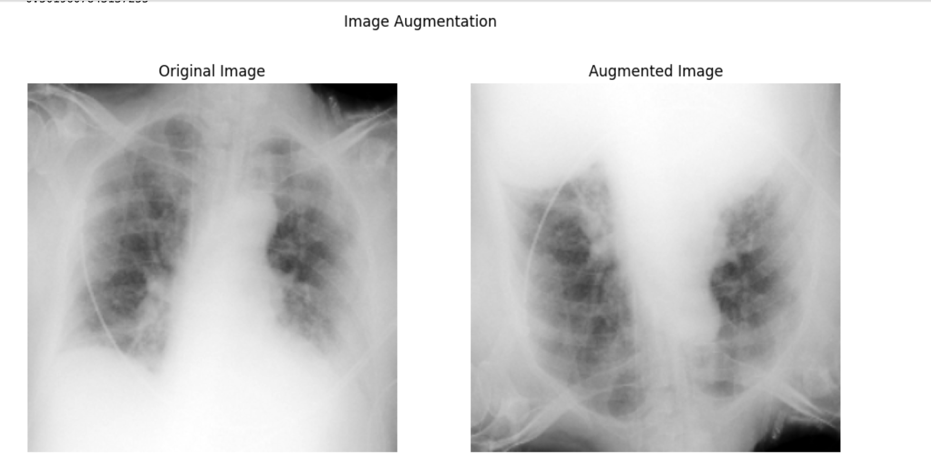
Data Augmentation
Because of the symmetry seen in the location of high correlation coefficients across a horizontal line (slide 26), we decided to add vertically flipped versions of each training image. The augmented images will increase the variability of the correlated features, allowing our models to better understand the full range of their values.
Data Summary after preprocessing/cleaning
Training set: 904 images
Test set: 120 images
Additional test set: 867 images.

Slide 31
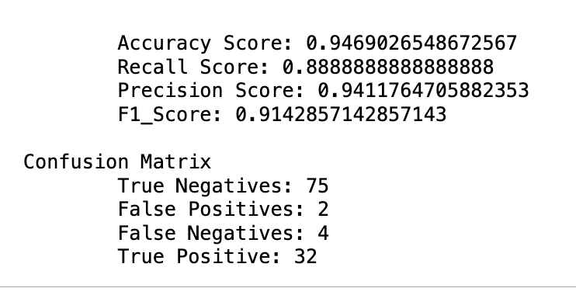
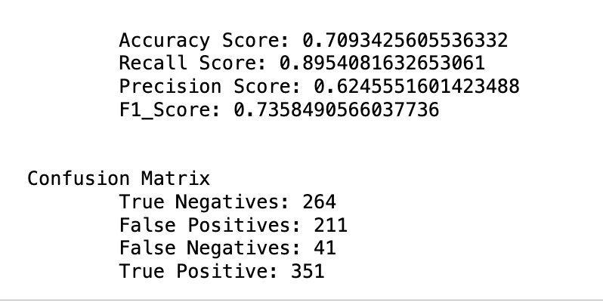
Description of Baseline
The scores seen below were used as a baseline for model tuning. The scores you see are only for logistic regression, however all other models were performing similarly with respect to the large test set.
Goal: Improve Scores on the Large test set, while maintaining performance on the small test set.
Small Test Set Large Test Set

Slide 32
Further Exploratory Data Analysis
-Missing Values: there were no missing values for any variables in this dataset
-Range: Features scaled from 0 to 1; minimum range size for any given feature is 0.66
-Correlation: Features closer to each other have higher correlation
-Average correlation of 0.97 with others within 5 features away from them
-Average correlation of 0.84 with others within 25 features away from them
-Average correlation of 0.5 with others within 125 features away from them

Slide 33
Datasets for Modeling Summary
Image split: 224x224
Image split: 224x224; remove outliers
Image split: 256x256; cropped images
Image split: 256x256; cropped images; remove outliers
Image split: 256x256; cropped images; remove outliers; data augmentation with vertical image flipping
Image split: 256x256; cropped images; remove outliers; remove irrelevant features
Image split: 256x256; cropped images; remove outliers; data augmentation with vertical image flipping; remove irrelevant features

Slide 34
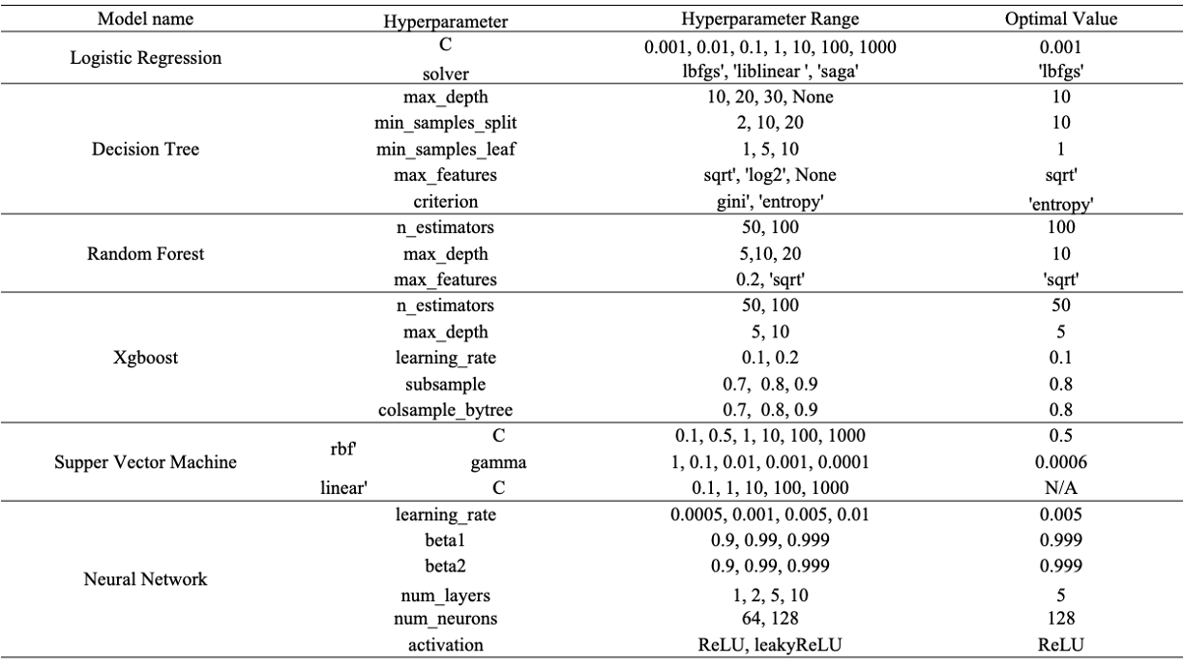
Hyperparameters

Slide 35
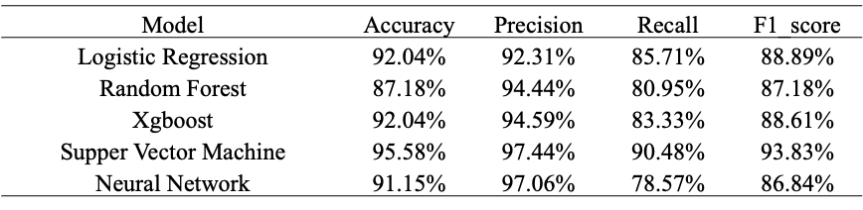
Evaluation on small test data

Slide 36
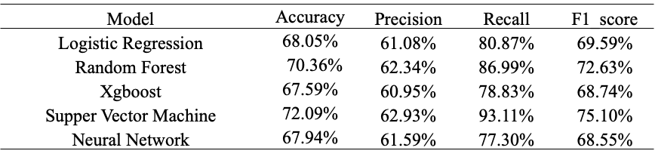
Evaluation on large test data

Slide 37
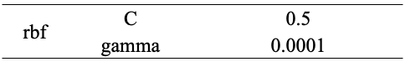
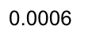
Conclusion
Best Model: SVM
Parameters:
Model does fairly well on test set AND has the highest scores when running model on outside data as well

Slide 38
Additional Analysis
Regrouped data to put all covid-19 and pneumonia images into one category and all normal images into another.
Positive class - 522 images
Negative class - 382 images

Slide 39
Additional Analysis Modeling
Model | Recall Before | Recall After
Logistic Regression | 93% | 89%
SVM | 97% | 87%
Neural Network | 91% | 49%
Conclusion: Models are better able to distinguish between covid and pneumonia, than they are to distinguish between sick lungs (covid or pneumonia) and healthy lungs

Slide 40
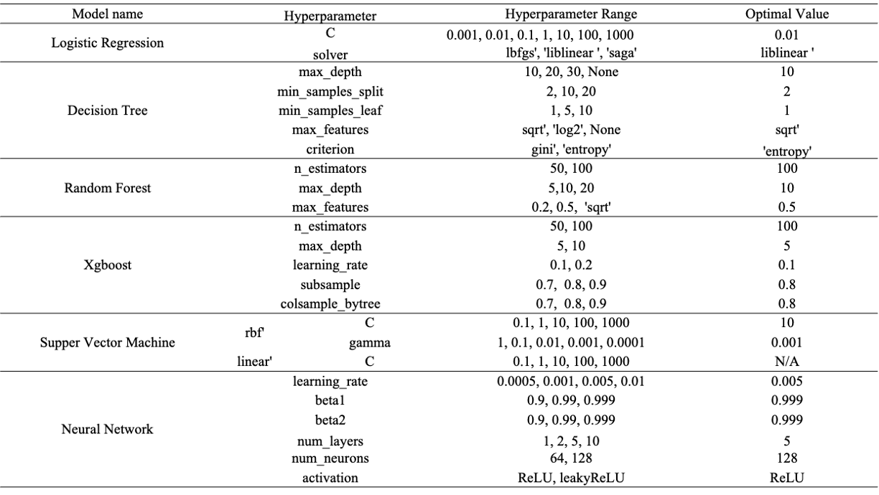
Additional Analysis Hyperparameters

Slide 41
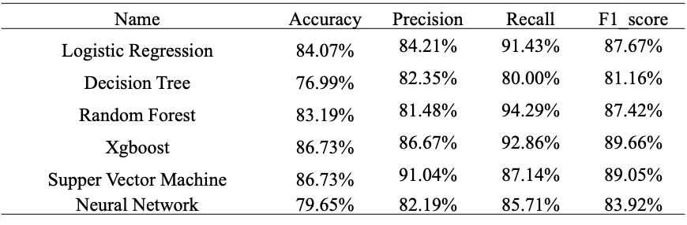
Additional Analysis Modeling

Slide 42
Questions?

